Slide 1
When Do We Need Emergency Services?
Analysing Vic Roads crash data
August 2023
Andre Medina

Slide 2
Why?
How many emergency services do we need?
Should we reallocate the current distribution?
Where should we send Ambulances & Police in the moment?

Slide 3
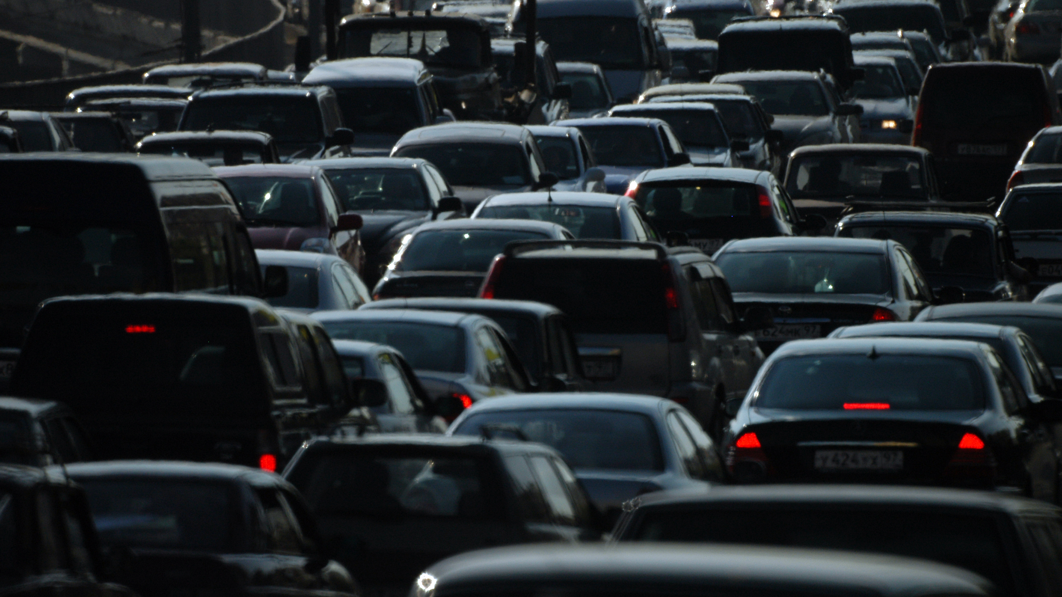
How?
The crash data!
Find key metrics
Group the crashes
Number of times 000 arrived
Create a statical model

Slide 4
Major steps
Investigating data structure
Viewing initial trends
Further data cleaning
Final statistical model
General data wrangling

Slide 5

Investigating Structure & Wrangling Data

Slide 6
Initial Data Structure
Pre-Crash data
Time of accident
Atmospheric condition
Road condition
Local Government Area (LGA)
Light Condition
Post-Crash data
Severity
Number of people involved
Accident Type
Police Needed
Ambulance Needed

Slide 7
Simplifying Data
Pre-Crash data
Day of the week
Part of the day
Atmospheric condition
Road condition
LGA / Region
Post-Crash data
Police Needed
Ambulance Needed
Notes:
with his data,
need to simpily
find a middle between time groups
that are too small and too big

Slide 8

Ambulance Needed
Only one ambulance per crash
Each person of a crash had their injury severity recorded
If someone was taken to the hospital, it was recorded

Slide 9

Viewing Initial Trends

Slide 10
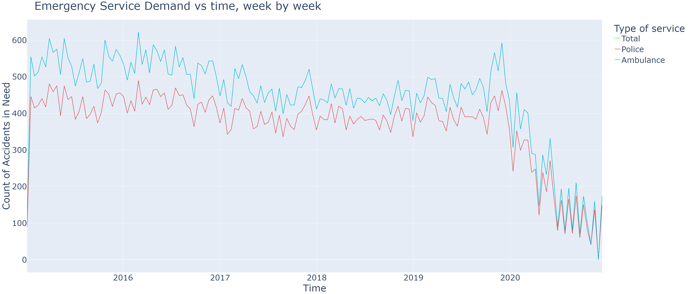
Emergency Callouts Over Time (Fortnightly)
Notes:
crash count over time, grouping fortnightly
High correlation Pollice vs Ambulance
Where’s the green line?
2020 onwards

Slide 11
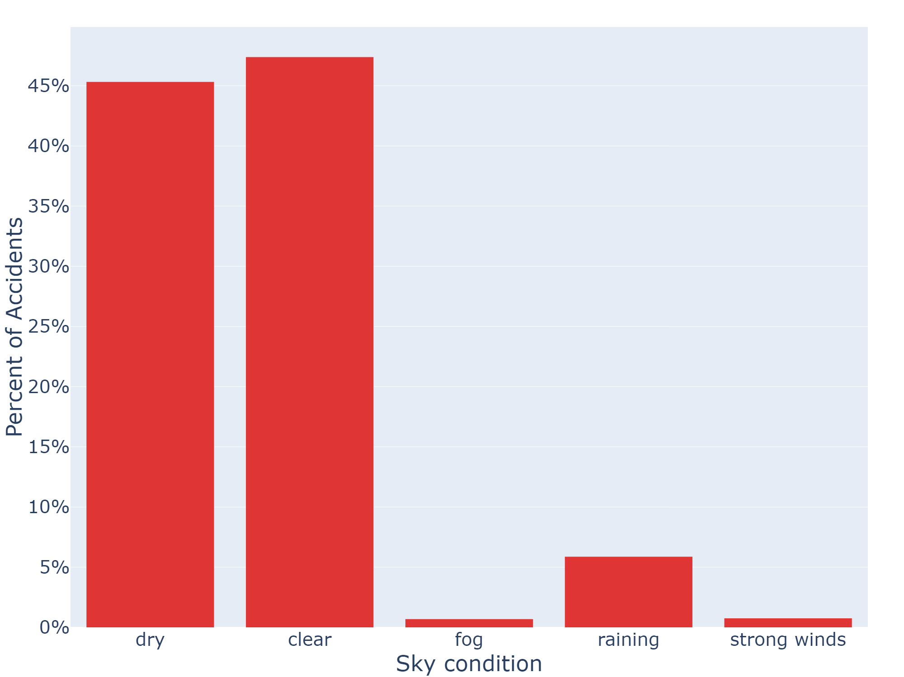
Crashes by Road and Sky Conditions
Notes:
need to remove some variables
not many accidents have fog or wind reported
looking at the interaction between them

Slide 12
Correlation of Conditions
Notes:
This shows the how strongly the conditions are related
red means highly correlated
blue is less correlated
if something is highly correlated, it will often happen together
if

Slide 13
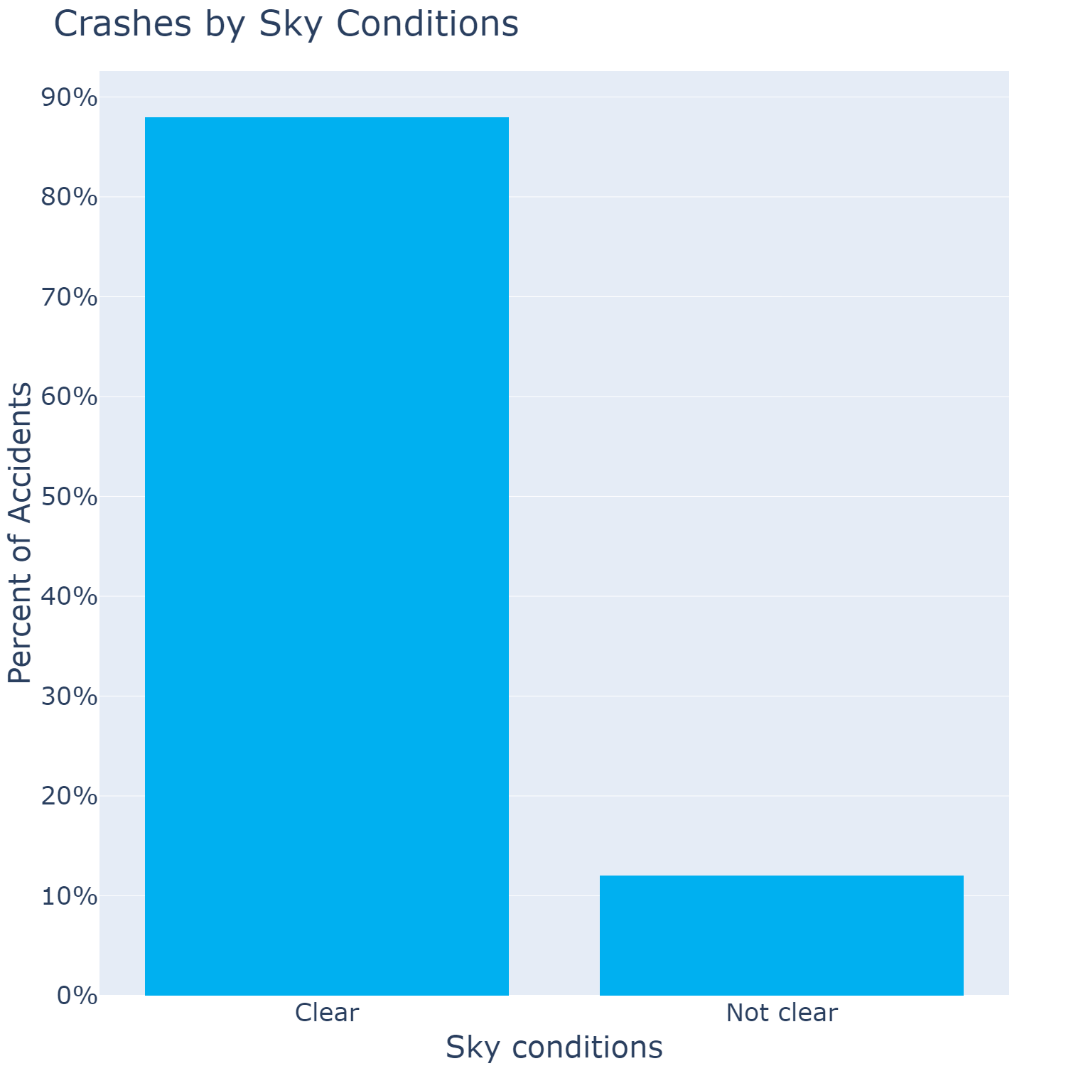
Emergency Callouts by Sky Conditions
Notes:
simplified road and atmospheric conditions into one
clear vs not clear
Note:
not clear =/= safer
sampling bias
less non clear rainy days

Slide 14
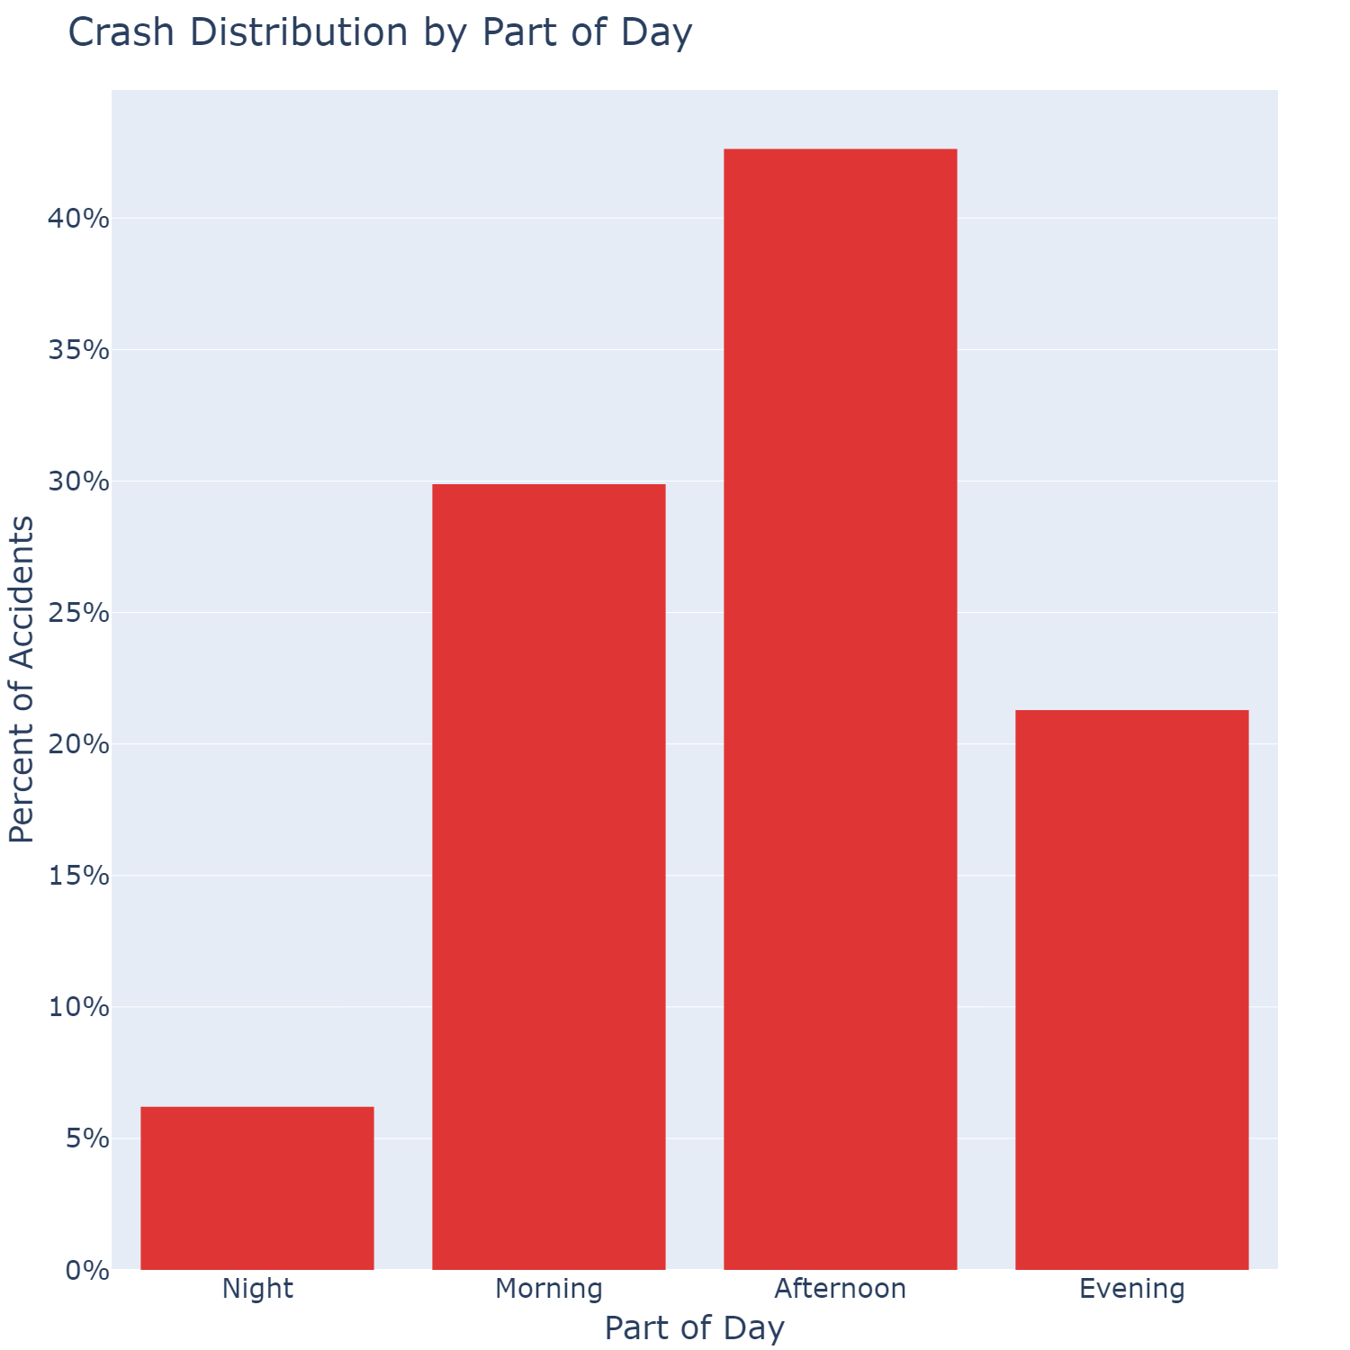
Emergency Callouts by Part of Day
Notes:
Shows what part of the day accidents occur at
clearly information here

Slide 15
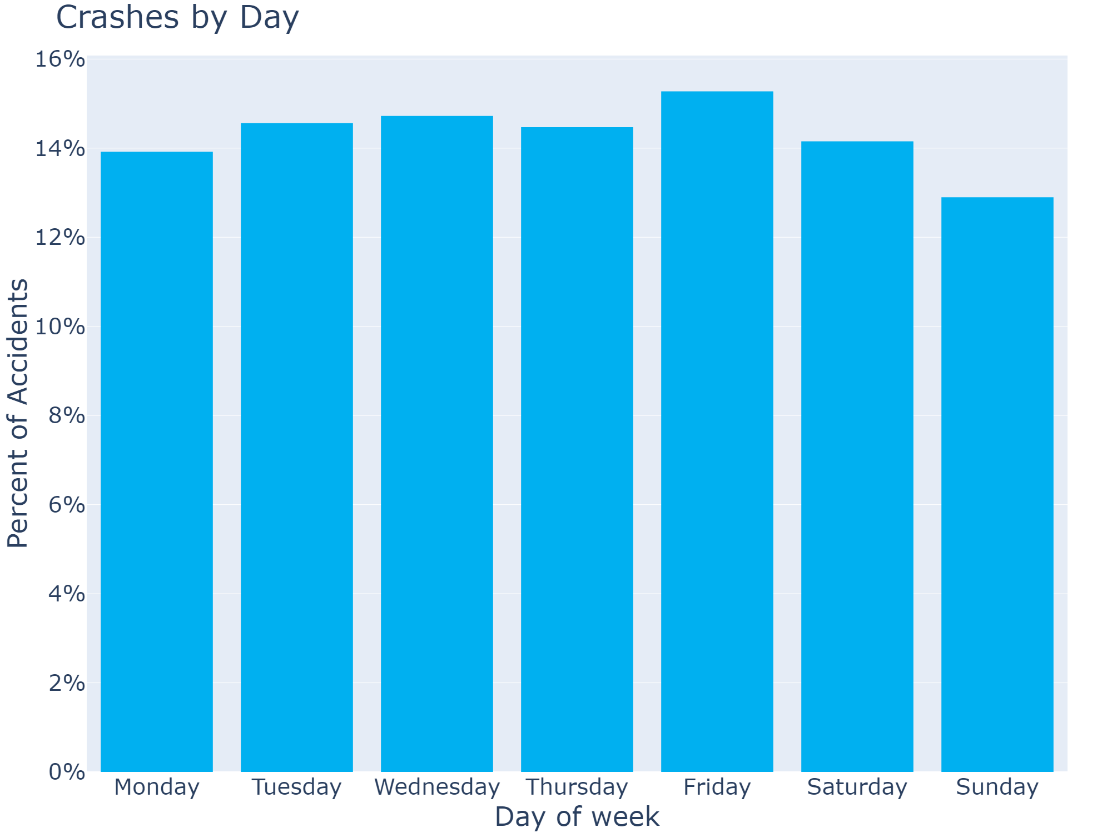
Emergency Callouts Over Time
Notes:
what day of the week crashes occur

Slide 16
Crashes by Day
Notes:
This does not show correlation directly
This is showing
for each time of day
what day of the week
has most accidents
Nothing statistical to take away,
just that there is some interaction
so shouldn’t throw away day of the week data

Slide 17

Further Cleaning

Slide 18
Target Format
For each combination of
Sky condition
Region
Day of the week
Part of the day
Calculate average number of emergency services
Notes:
give example
clear
northwest metro area
on a Friday evening
on avg you get 6 crashes
raining
eastern regional
on a Monday morning
on avg you might get 1/2 crash

Slide 19
Potential Issues
Regional areas have smaller number of samples
Data is already split up into rainy days and clear days
Infrequent rainy days will skew data
Use probability of a rainy day to compensate
Data is both summated and averaged over time
Notes:
Potential issues
regional data is small
that’s fine, small pop -> less traffic and crashes
Rainy days
over a year, each day is either clear or not
so not a full spread of either clear or not clear samples
extrapolate each weather to cover every week
scale by probability it will rain or be clear
assume data set is big enough to give good weather distribution
count number of days it rains vs number of days its clear (leave only one crash each time)
use pr(rain) to scale rain and clear
time issue
largest time range of group is a week
Must sum data into this grouping
devide by the number of weeks to create average number

Slide 20
Cleaned Data Averaged Over Days
Not clear
Clear
Part of Day
Notes:
Busy graph,
- hard to display this data nicely
showing the final data format
averaged over days of the week
some low values
0.10, ambulace is only called 1 in 10 times
some high values
- 4.99, 5 ambulances are called on average

Slide 21

Final Statistical Model

Slide 22
Distribution of Features

Slide 23
Interaction of Features
Notes:
Another busy technical visual
we can come back to this later
pretty much,
the bottom three graphs show
interaction between
day of the week, part of day and sky
with region
shows there’s not much interaction
however the top
shows interaction with the other terms
clearly there is interaction
eg
crossing of lines in
top right

Slide 24
Model of choice: Gamma General Linear Model (GLM)
Statistical model allows for prediction and understanding inner workings
Good for continuous data
Good for data between 0 and infinity
Notes:
why chose a Statistical model
- General linear model
allows better insights
looking for insights, not just prediction and classification
data fits model
with a small transformation of plussing epsilon to the data,

Slide 25
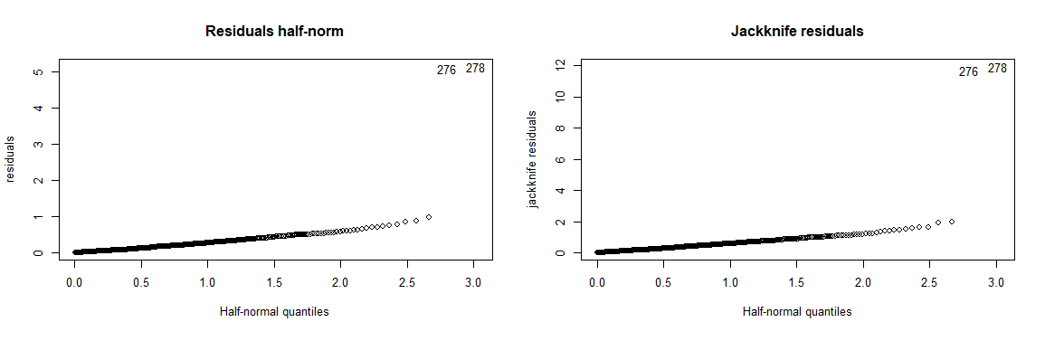
Oh oh! outliers!

Slide 26

Model Formula Gamma GLM
Region
Day of the Week
Part of Day
Sky condition
2-way interaction between
Day of the Week
Part of Day
Sky condition
Notes:
I used back selection and AIC different times
general
removed terms with interaction with region
kept other interaction
supports what we saw in the graphs before

Slide 27
Model Diagnostic Plots

Slide 28
Predicting Police Demand
Testing Data
Training Data
Notes:
RMSE
0.2652675
0.5131998

Slide 29
Predicting Ambulance Demand
Testing Data
Training Data
Notes:
RMSE
0.3426021
0.62

Slide 30
Statistical results
Metropolitan areas greatly increase the chance of need an ambulance
Evenings and nights decreases risk
Except Saturday and Sunday night
Mornings increased risk
Weather being not clear in the evening increased risk quite a bit
Whereas raining in the morning decreased risk
Raining itself wasn’t significant
Notes:
# analysis
# all with very high certainty
# metropolitain areas greatly increase the chance of need an ambulance
# evenings and nights generally decreases
# but sat and sunday night (so am firday and sat am) increased the risk
# mornings incrased chance, surprisingly monday morning didnt do much
# raining itself was inconclusive if it increaseed chance of ambulance
# Not clear in the evening increased risk quite a bit
# Where as raining in the morning decreased risk

Slide 31

Questions!

